Slide 1
Emerald Energy from Waste Public Liaison Committee Meeting 24-02
December 10, 2024

Slide 2
Agenda
No | Time | Item
1 | 6:00 | Introductions
2 | 6:10 | Review of Previous Minutes
3 | 6:15 | Previous Business
4 | 6:20 | New Business Operating Update Steam Line Replacement Update Hydrogen Pilot Project
5 | 6:40 | Redevelopment Project Update Screening Summary Next Steps
6 | 7:00 | Next Meeting & Adjournment
2 of 14

Slide 3
Operating Update (Unofficial)
3 of 14

Slide 4
Operating Update (Environmental)
 | 2023 | Q1 2024
Diversion Rate: | 81.4% | 84.1%
Environmental Incidents Q2 2024
Bypass Stack Use – April 3, 2024
Power surge in the Hydro One yard tripped the turbine, power was restored after 15 minutes
Bypass Stack open for ~23 minutes.
Reported to the MECP under incident # 1-5DIAQT.
4-Hr CO Exceedance at stack – June 17, 2024
Malfunction of Unit 5 Upper Chamber burner – Unit overheated.
Stack CO reached 44 ppm vs 43 ppm standard.
Reported to the MECP under incident # 7QDG6Q.
Environmental Incidents Q3 2024
Bypass Stack Use – September 24, 2024
Power surge on site tripped the turbine.
Power surge was caused by a bird connecting 2 phases on the transformer.
Bypass Stack open for ~15 minutes.
Reported to the MECP under incident # 1-B99W7M.
4 of 14

Slide 5
2024 Stack Sampling
5 of 14

Slide 6
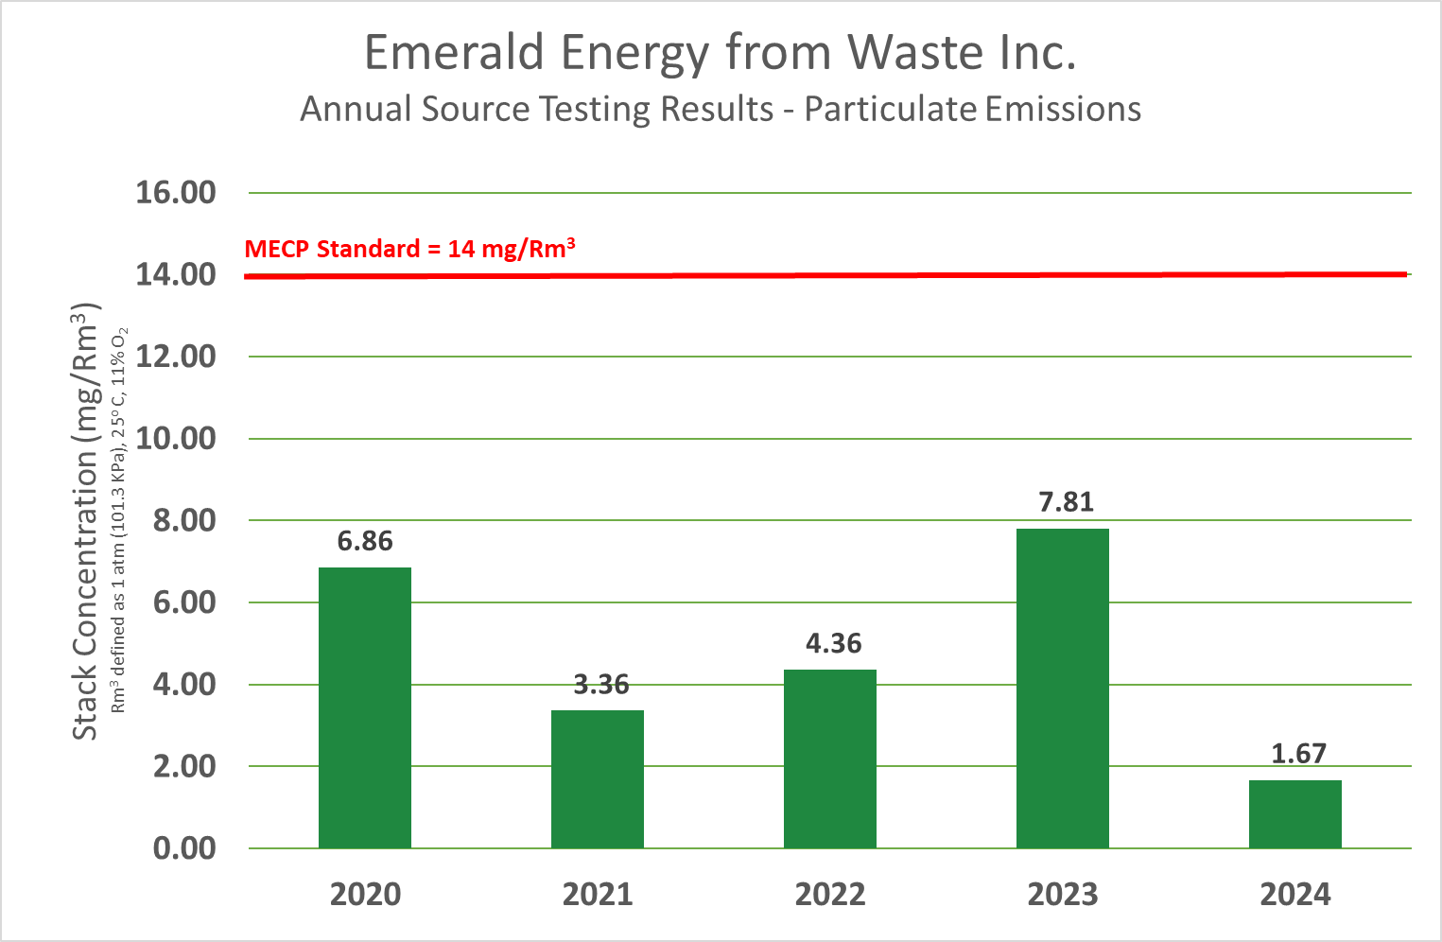
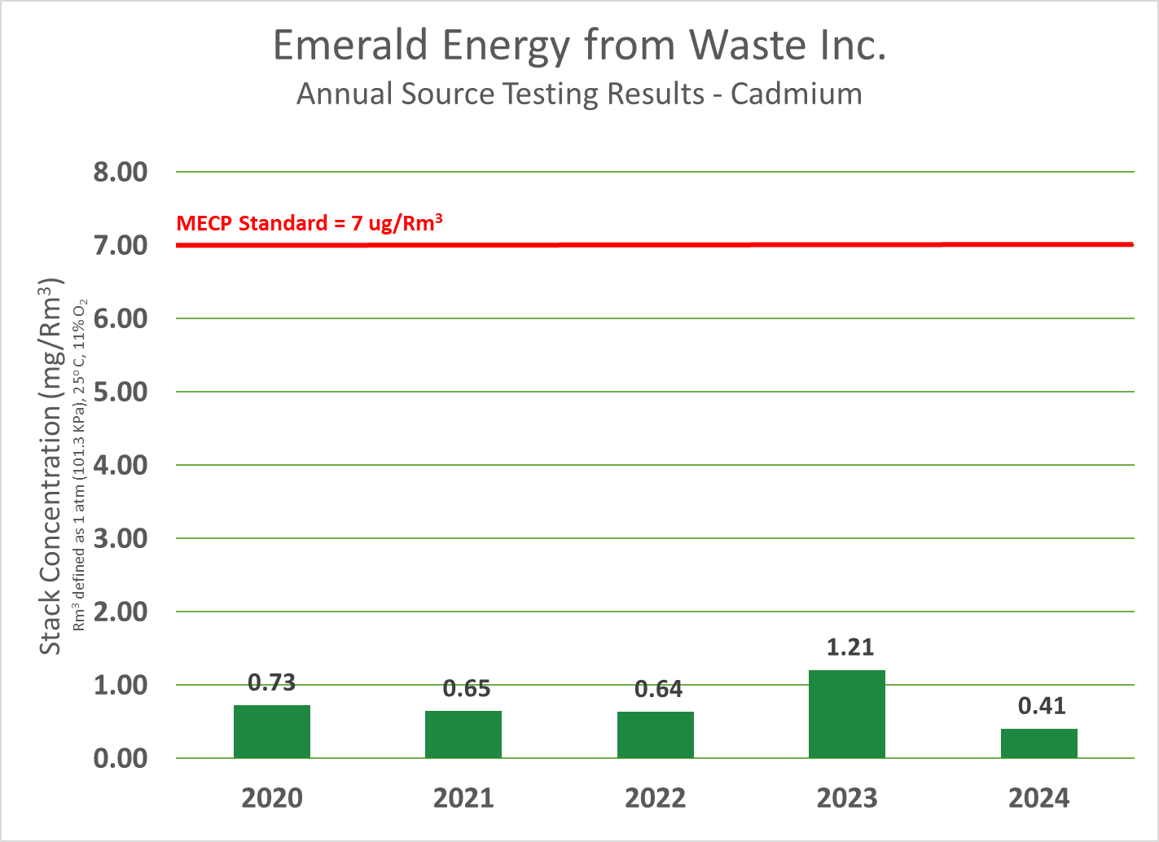
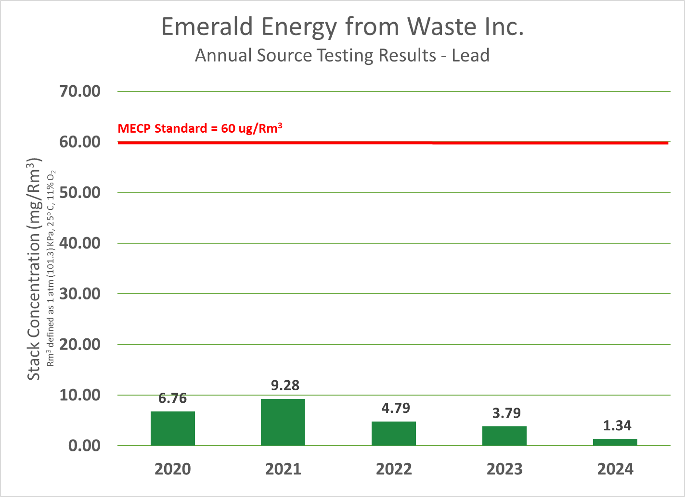
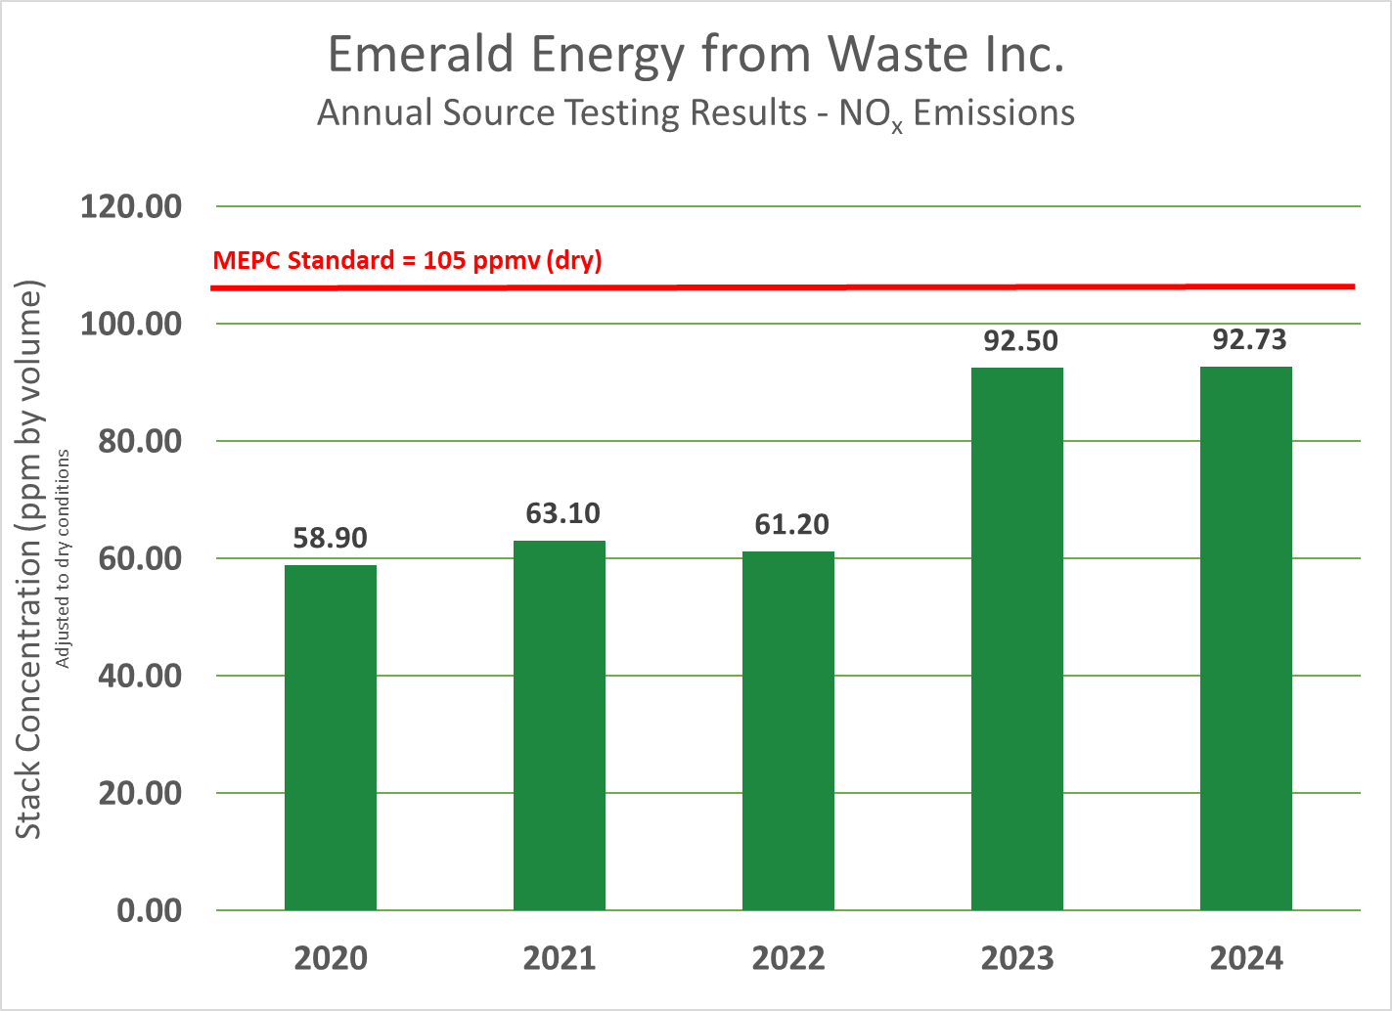
6 of 14

Slide 7
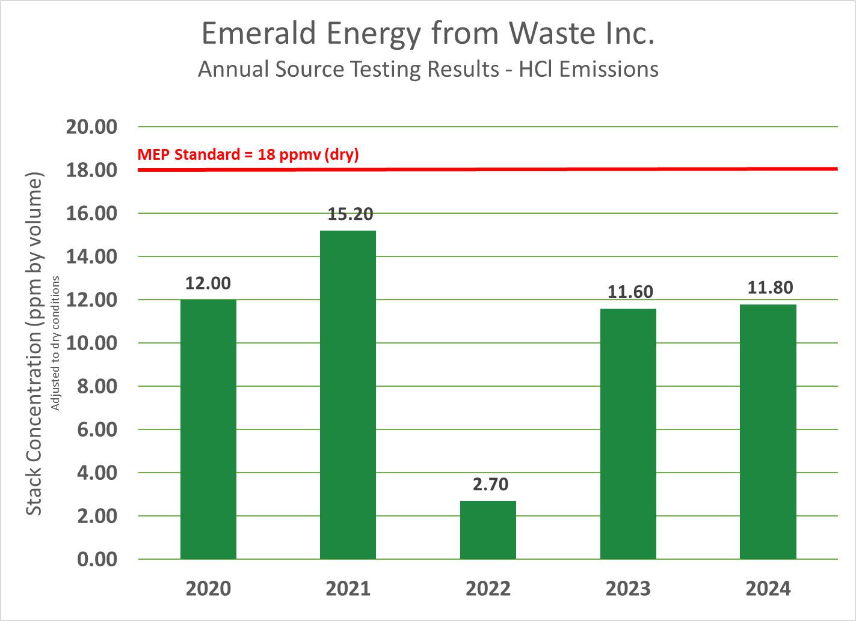
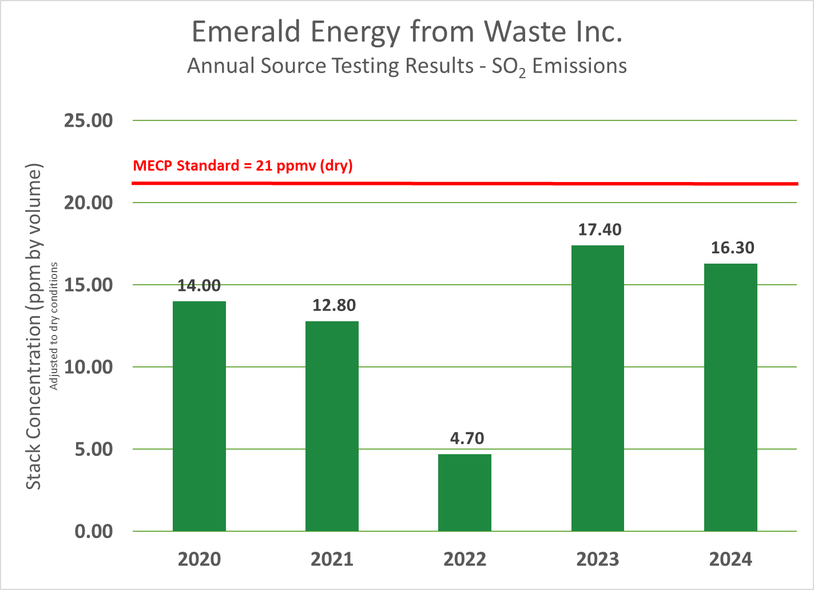
7 of 14

Slide 8
Steam Line Replacement
Steam Line Replacement
Conditional approval for HONI lands (s.t. archaeological assessment).
Pipe bridge installation underway.
Bramalea Crossing moved to winter.
East side replacement to be done over next 2 or 3 years.
8 of 14

Slide 9
Hydrogen Pilot Project
Received proposal from NextHydrogen – Mississauga company.
Commercialization of 2nd Generation of production equipment.
Alkaline process with significant efficiency upgrades.
More H₂ yield per MWh.
Scheduled installation and operation by Dec 1, 2025.
Pursuing fuel cell vehicle trials in Peel, York, Simcoe.
Evaluating quotes for hydrogen injection systems for UPak trucks.
9 of 14

Slide 10
Redevelopment Project - Summary
10 of 14

Slide 11
Redevelopment Project – Summary
11 of 14

Slide 12
Redevelopment Project Update
12 of 14

Slide 13
Redevelopment – Next Steps
Received comments from regulators (Peel, MECP) and coalition of environmental organizations represented by Environmental Defense.
Reports were in response to comments.
Final reports completed in November, open for comment until January 7th.
Received proposals from vendors (Babcock-Wilcox, Hitachi-Zosen-Inova).
13 of 14

Slide 14
Next Meeting & Adjournment
Meeting format:
In-person
Teams
Date/Time for next meeting TBD (February 2024)
14 of 14

